Slide 1
24
7
30
Algebra
Date
EQ – How is factorising similar to distribution
Factorising is the opposite of distribution
a(b+c) = a x b + a x c
= ab + ac
Distribution
Step 1: Find the highest common factor (HCF)
Step 2: Write the HCF outside brackets
Step 3: Divide the terms by the HCF
Step 4: Write the result inside the brackets

Slide 2
24
7
30
Algebra
Date
EQ – How is factorising similar to distribution
3x + 6 HCF = 3
Step 1: Find the highest common factor (HCF)
3( )
Step 2: Write the HCF outside brackets
3x ÷ 3 = x
6 ÷ 3 = 2
Step 3: Divide the terms by the HCF
3(x + 2 )
Step 4: Write the result inside the brackets

Slide 3
24
7
30
Algebra
Date
EQ – Describe how we use the distributive law to expand brackets
Example 1: Factorise 12n + 20n
First draw a pair of brackets.
Look to see if any of the numbers have a common factor.
Look to see if any of the letters have a
common factor.
4
( )
3n + 5n
4 is a factor of both 12 and 20, so write this outside the brackets.
4
n
n is a common factor, so write this outside the brackets.
( )
3 + 5
Divide each term by 4 and write these inside the brackets.
Divide each term inside the brackets
by n.
So the answer is:
4n(3 + 5)

Slide 4
24
7
30
Algebra
Date
EQ – Describe how we use the distributive law to expand brackets
Example 2: Factorise 6ab + 4b
First draw a pair of brackets.
Look to see if any of the numbers have a common factor.
Look to see if any of the letters have a
common factor.
2
( )
3ab + 2b
2 is a factor of both 6 and 4, so write this outside the brackets.
2
b
b is a common factor, so write this outside the brackets.
( )
3a + 2
Divide each term by 2 and write these inside the brackets.
Divide each term inside the brackets
by b.
So the answer is:
2b(3a + 2)

Slide 5
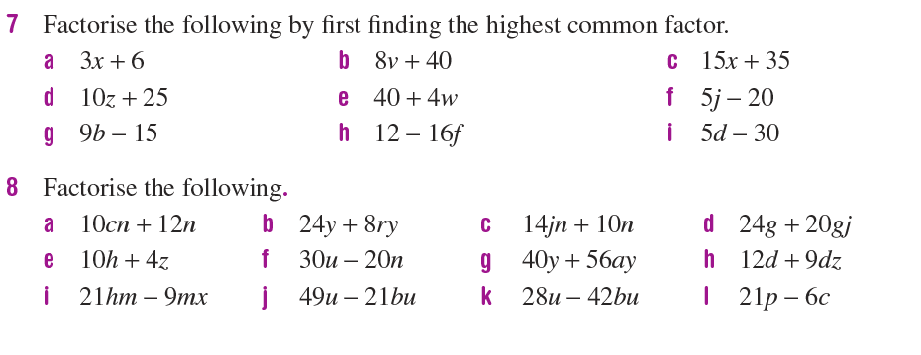
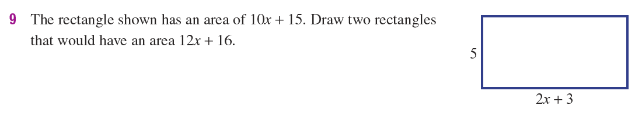
24
7
30
Algebra
Date
EQ – Describe how we use the distributive law to expand brackets

